Slide 1


EEE 598: Co-Design and Modelling of Advanced Semiconductor
Packaging
Thermo-Mechanical Analysis of Solder Joint in 3D Chiplet Package with Varying Pitch Gap and Solder Joint Height
Team Members:
Sherry Daniel Sajan (1225838460)
Jonathan Reggie Ebenezer (1231742293)
Venkata Subrahmanya Krishna Vamshi Vemuri (1229568654)
Himanshu Parashar (1230162637)
Jay Hemal Nanavati (1229454137)

Slide 2
METHODOLOGY:
Advanced Modeling: Leveraged ANSYS Workbench Mechanical for detailed chiplet and solder joint modeling.
Thermal Analysis: Steady-State thermal analysis in ANSYS Workbench to understand heat dissipation, hotspots, and thermal performance.
Mechanical Analysis: Static Structural in ANSYS Workbench to assess thermo-mechanical Stresses and Strains.
Parametric Analysis: Simulated miniaturized designs by varying pitch gap and solder joint height.
RESEARCH QUESTION:
How does varying the pitch gap and solder joint height affect thermal accumulation, and solder joint performance, and how can Thermal and Mechanical Analysis play a role in optimizing the overall performance?
IMPORTANCE:
Tackles design and reliability challenges in 3D chiplet packaging by analyzing pitch gap and solder joint height.
Integrates thermal, mechanical, and electronic performance to optimize solder joint designs.
Mitigates hotspots and fatigue, ensuring robust, high-performance applications while addressing manufacturing challenges.

Slide 3
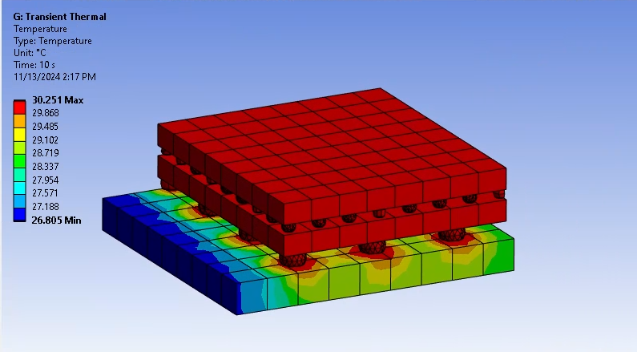
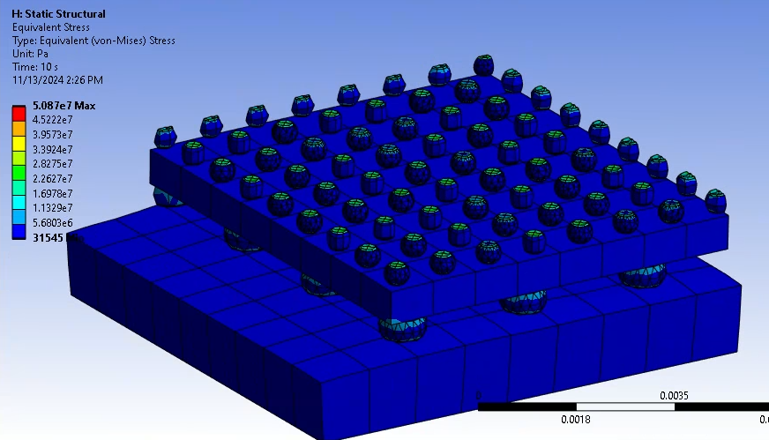
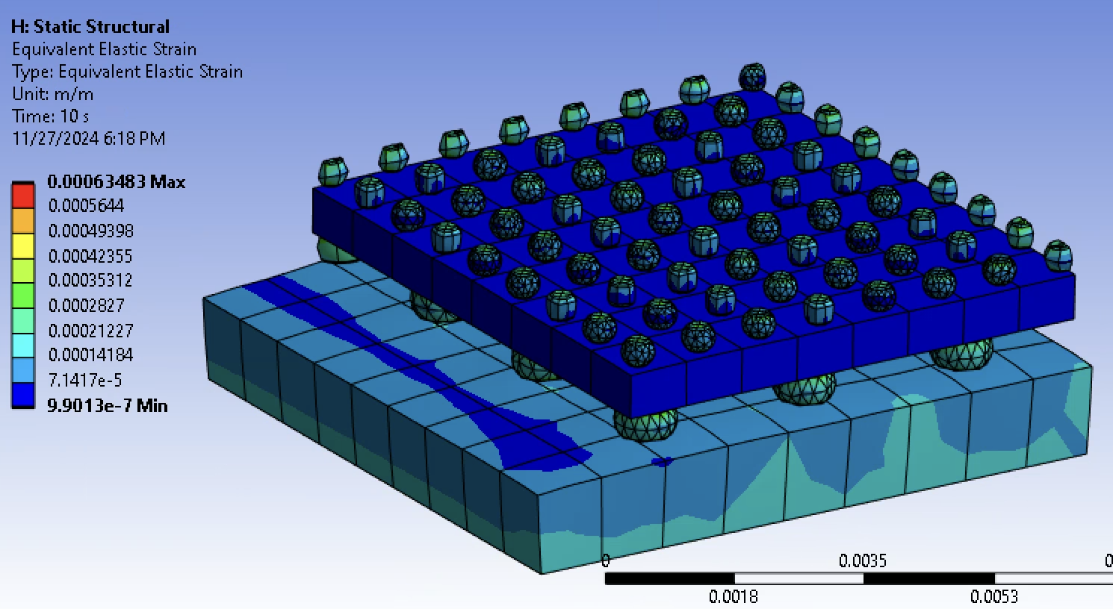
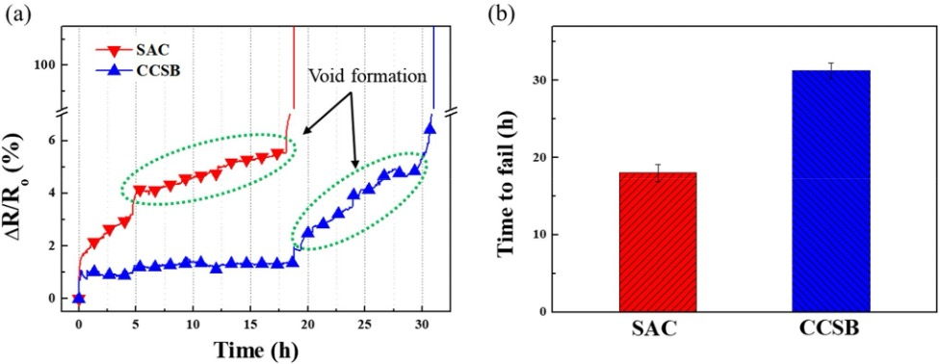
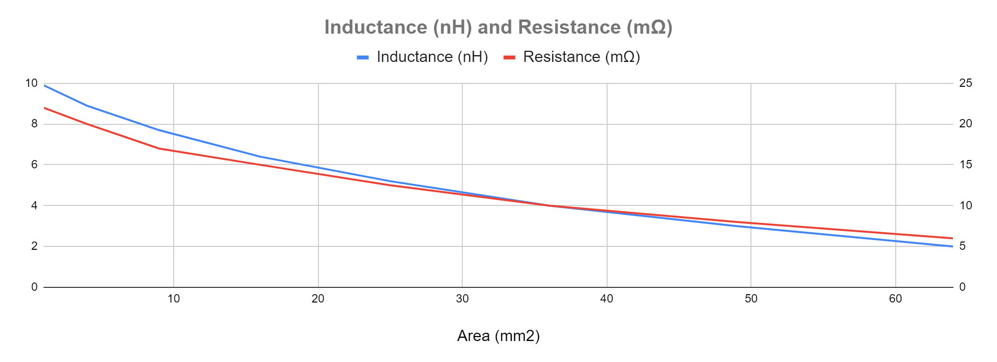
RESULTS & IMPORTANCE:
Results show impact of pitch gap and solder joint height on thermal, mechanical, electrical performance. Electromigration analysis confirms Cu core solder balls (CCSBs) outperform traditional SAC joints by reducing current density and enhancing thermal dissipation, improving reliability. These findings are essential for designing robust and efficient solder joints in miniaturized electronics.
Pitch 2.5 mm - Temperature distribution
Pitch 2.5mm - Stress Distribution
CONCLUSIONS:
Thermal Analysis reveals the relationship between pitch gap, solder height, and thermal performance. Identified optimal design parameters to manage hotspots and improve heat dissipation.
Mechanical Analysis: Showed stress and strain distribution patterns with varying solder dimensions.
Electrical Analysis: Demonstrated the superiority of CCSBs over SAC solder joints in reliability. Proved CCSBs reduce void formation and enhance time-to-failure under stress. Also gained insight on electromigration and relationship between parasitics and dimensions.
Pitch 2.5mm - Strain Distribution
Result of Electromigration for SAC and CCSB Joints
Parasitics vs Contact Area of Terminal Connectors

